Slide 1
3.3 Balanced Search Trees
Algorithms
Robert Sedgewick | Kevin Wayne
2-3 search trees
B-trees

Slide 2
Symbol table review
Challenge. Guarantee performance.
This lecture. 2-3 trees, B-trees.
implementation | guarantee |  |  | average case
 | search | insert | delete | search hit | insert | delete
sequential search (unordered list) | N | N | N | ½ N | N | ½ N
binary search (ordered array) | lg N | N | N | lg N | ½ N | ½ N
BST | N | N | N | 1.39 lg N | 1.39 lg N | √ N
goal | log N | log N | log N | log N | log N | log N
Notes:
we don't have control over the order of the operations and they may not be random

Slide 3


3.3 Balanced Search Trees
2-3 search trees
- B-trees
http://algs4.cs.princeton.edu

Slide 4
2-3 tree
Allow 1 or 2 keys per node.
2-node: one key, two children.
3-node: two keys, three children.
Symmetric order. In order traversal yields keys in ascending order.
Perfect balance. Every path from root to null link has same length.
M
how to maintain?
3-node
2-node
smaller than E
E
J
R
larger than J
A
C
H
L
P
S
X
between E and J
null link
Notes:
generalize what we put in a BST node
challenge: how to guarantee perfect balance

Slide 5
2-3 tree
Definition. A 2-3 search tree is a tree that is either empty or
2-node, with one key (and associated value) and two links, a left link to a 2-3 search tree with smaller keys, and a right link to a 2-3 search tree with larger keys
A 3-node, with two keys (and associated values) and three links, a left link to a 2-3 search tree with smaller keys, a middle link to a 2-3 search tree with keys between the node’s keys, and a right link to a 2-3 search tree with larger keys. As usual, we refer to a link to an empty tree as a null link.
M
3-node
2-node
smaller than E
E
J
R
larger than J
A
C
H
L
P
S
X
between E and J
null link
Notes:
generalize what we put in a BST node
challenge: how to guarantee perfect balance

Slide 6
3.3 2-3 Tree Demo
search
insertion
construction
http://algs4.cs.princeton.edu

Slide 7
2-3 tree demo: search
Search.
Compare search key against keys in node.
Find interval containing search key.
Follow associated link (recursively).
search for H
H is less than M
(go left)
H
M
E
J
R
A
C
H
L
P
S
X

Slide 8
2-3 tree demo: search
Search.
Compare search key against keys in node.
Find interval containing search key.
Follow associated link (recursively).
search for H
M
H is between E and J
(go middle)
H
E
J
R
A
C
H
L
P
S
X

Slide 9
2-3 tree demo: search
Search.
Compare search key against keys in node.
Find interval containing search key.
Follow associated link (recursively).
search for H
M
E
J
R
A
C
H
H
L
P
S
X
found H
(search hit)

Slide 10
2-3 tree demo: search
Search.
Compare search key against keys in node.
Find interval containing search key.
Follow associated link (recursively).
search for B
B is less than M
(go left)
B
M
E
J
R
A
C
H
L
P
S
X

Slide 11
2-3 tree demo: search
Search.
Compare search key against keys in node.
Find interval containing search key.
Follow associated link (recursively).
search for B
M
B is less than E
(go left)
B
E
J
R
A
C
H
L
P
S
X

Slide 12
2-3 tree demo: search
Search.
Compare search key against keys in node.
Find interval containing search key.
Follow associated link (recursively).
search for B
M
E
J
R
B is between A and C
(go middle)
B
A
C
H
L
P
S
X

Slide 13
2-3 tree demo: search
Search.
Compare search key against keys in node.
Find interval containing search key.
Follow associated link (recursively).
search for B
M
E
J
R
A
C
H
L
P
S
X
B
link is null
(search miss)

Slide 14
3.3 2-3 Tree Demo
search
insertion
construction
http://algs4.cs.princeton.edu

Slide 15
2-3 tree demo: insertion
Insert into a 2-node at bottom.
Search for key, as usual.
Replace 2-node with 3-node.
insert K
K is less than M
(go left)
K
M
E
J
R
A
C
H
L
P
S
X

Slide 16
2-3 tree demo: insertion
Insert into a 2-node at bottom.
Search for key, as usual.
Replace 2-node with 3-node.
insert K
M
K is greater than J
(go right)
K
E
J
R
A
C
H
L
P
S
X

Slide 17
2-3 tree demo: insertion
Insert into a 2-node at bottom.
Search for key, as usual.
Replace 2-node with 3-node.
insert K
M
E
J
R
A
C
H
K
L
P
S
X
search ends here

Slide 18
2-3 tree demo: insertion
Insert into a 2-node at bottom.
Search for key, as usual.
Replace 2-node with 3-node.
insert K
M
E
J
R
A
C
H
K
L
P
S
X
L
replace 2-node with
3-node containing K

Slide 19
2-3 tree demo: insertion
Insert into a 2-node at bottom.
Search for key, as usual.
Replace 2-node with 3-node.
insert K
M
M
R
J
R
E
J
E
A
A
C
C
H
H
P
P
S
S
X
K
X
L
L

Slide 20
2-3 tree demo: insertion
Insert into a 3-node at bottom.
Add new key to 3-node to create temporary 4-node.
Move middle key in 4-node into parent.
insert Z
Z is greater than M
(go right)
M
Z
E
J
R
A
C
H
K
L
P
S
X
Notes:
Q. why middle key?
A. Otherwise violates symmetric order.

Slide 21
2-3 tree demo: insertion
Insert into a 3-node at bottom.
Add new key to 3-node to create temporary 4-node.
Move middle key in 4-node into parent.
insert Z
M
Z is greater than R
(go right)
E
J
R
Z
A
C
H
K
L
P
S
X

Slide 22
2-3 tree demo: insertion
Insert into a 3-node at bottom.
Add new key to 3-node to create temporary 4-node.
Move middle key in 4-node into parent.
insert Z
M
E
J
R
A
C
H
K
L
P
S
X
Z
search ends here

Slide 23
2-3 tree demo: insertion
Insert into a 3-node at bottom.
Add new key to 3-node to create temporary 4-node.
Move middle key in 4-node into parent.
insert Z
M
E
J
R
A
C
H
K
L
P
S
X
Z
replace 3-node with
temporary 4-node containing Z

Slide 24
2-3 tree demo: insertion
Insert into a 3-node at bottom.
Add new key to 3-node to create temporary 4-node.
Move middle key in 4-node into parent.
insert Z
M
E
J
R
A
C
H
K
L
P
S
X
Z

Slide 25
2-3 tree demo: insertion
Insert into a 3-node at bottom.
Add new key to 3-node to create temporary 4-node.
Move middle key in 4-node into parent.
insert Z
M
E
J
R
A
C
H
K
L
P
S
X
Z
split 4-node into two 2-nodes
(pass middle key to parent)
Notes:
Q. why middle key?
A. Otherwise violates symmetric order.

Slide 26
2-3 tree demo: insertion
Insert into a 3-node at bottom.
Add new key to 3-node to create temporary 4-node.
Move middle key in 4-node into parent.
insert Z
M
E
J
R
X
A
C
H
K
L
P
S
Z
Notes:
this is a magical operation. Easier to do it in the graphics than the implementation!

Slide 27
2-3 tree demo: insertion
Insert into a 3-node at bottom.
Add new key to 3-node to create temporary 4-node.
Move middle key in 4-node into parent.
insert Z
M
E
J
R
X
A
C
H
K
L
P
S
Z

Slide 28
2-3 tree demo: insertion
Insert into a 3-node at bottom.
Add new key to 3-node to create temporary 4-node.
Move middle key in 4-node into parent.
Repeat up the tree, as necessary.
If you reach the root and it's a 4-node, split it into three 2-nodes.
insert L
E
R
A
C
H
P
L
S
X
convert 3-node into 4-node

Slide 29
2-3 tree demo: insertion
Insert into a 3-node at bottom.
Add new key to 3-node to create temporary 4-node.
Move middle key in 4-node into parent.
Repeat up the tree, as necessary.
If you reach the root and it's a 4-node, split it into three 2-nodes.
insert L
E
R
A
C
H
L
P
S
X

Slide 30
2-3 tree demo: insertion
Insert into a 3-node at bottom.
Add new key to 3-node to create temporary 4-node.
Move middle key in 4-node into parent.
Repeat up the tree, as necessary.
If you reach the root and it's a 4-node, split it into three 2-nodes.
insert L
E
R
A
C
H
L
P
S
X
split 4-node
(move L to parent)

Slide 31
2-3 tree demo: insertion
Insert into a 3-node at bottom.
Add new key to 3-node to create temporary 4-node.
Move middle key in 4-node into parent.
Repeat up the tree, as necessary.
If you reach the root and it's a 4-node, split it into three 2-nodes.
insert L
E
L
R
A
C
H
P
S
X

Slide 32
2-3 tree demo: insertion
Insert into a 3-node at bottom.
Add new key to 3-node to create temporary 4-node.
Move middle key in 4-node into parent.
Repeat up the tree, as necessary.
If you reach the root and it's a 4-node, split it into three 2-nodes.
insert L
split 4-node
(move L to parent)
E
L
R
A
C
H
P
S
X
Notes:
Q. What if you reach root, and root is a 3-node?

Slide 33
2-3 tree demo: insertion
Insert into a 3-node at bottom.
Add new key to 3-node to create temporary 4-node.
Move middle key in 4-node into parent.
Repeat up the tree, as necessary.
If you reach the root and it's a 4-node, split it into three 2-nodes.
height of tree increases by 1
insert L
L
E
R
A
C
H
P
S
X

Slide 34
2-3 tree demo: insertion
Insert into a 3-node at bottom.
Add new key to 3-node to create temporary 4-node.
Move middle key in 4-node into parent.
Repeat up the tree, as necessary.
If you reach the root and it's a 4-node, split it into three 2-nodes.
insert L
L
E
R
A
C
H
P
S
X

Slide 35
3.3 2-3 Tree Demo
search
insertion
construction
http://algs4.cs.princeton.edu

Slide 36
2-3 tree demo: construction
insert S
S

Slide 37
2-3 tree demo: construction
2-3 tree
S

Slide 38
2-3 tree demo: construction
insert E
E
S
convert 2-node into 3-node

Slide 39
2-3 tree demo: construction
insert E
E
S

Slide 40
2-3 tree demo: construction
2-3 tree
E
S

Slide 41
2-3 tree demo: construction
insert A
A
E
S
convert 3-node into 4-node

Slide 42
2-3 tree demo: construction
insert A
A
E
S

Slide 43
2-3 tree demo: construction
insert A
A
E
S
split 4-node
(move E to parent)

Slide 44
2-3 tree demo: construction
insert A
E
A
S

Slide 45
2-3 tree demo: construction
2-3 tree
E
A
S

Slide 46
2-3 tree demo: construction
insert R
E
A
R
S
convert 2-node into 3-node

Slide 47
2-3 tree demo: construction
insert R
E
A
R
S

Slide 48
2-3 tree demo: construction
2-3 tree
E
A
R
S

Slide 49
2-3 tree demo: construction
insert C
E
A
C
R
S
convert 2-node into 3-node

Slide 50
2-3 tree demo: construction
insert C
E
A
C
R
S

Slide 51
2-3 tree demo: construction
2-3 tree
E
A
C
R
S

Slide 52
2-3 tree demo: construction
insert H
E
A
C
H
R
S
convert 3-node into 4-node

Slide 53
2-3 tree demo: construction
insert H
E
A
C
H
R
S

Slide 54
2-3 tree demo: construction
insert H
E
A
C
H
R
S
split 4-node
(move R to parent)

Slide 55
2-3 tree demo: construction
insert H
E
R
A
C
H
S

Slide 56
2-3 tree demo: construction
2-3 tree
E
R
A
C
H
S

Slide 57
2-3 tree demo: construction
insert X
E
R
A
C
H
S
X
convert 2-node into 3-node

Slide 58
2-3 tree demo: construction
insert X
E
R
A
C
H
S
X

Slide 59
2-3 tree demo: construction
2-3 tree
E
R
A
C
H
S
X

Slide 60
2-3 tree demo: construction
insert P
E
R
A
C
H
P
S
X
convert 2-node into 3-node

Slide 61
2-3 tree demo: construction
insert P
E
R
A
C
H
P
S
X

Slide 62
2-3 tree demo: construction
2-3 tree
E
R
A
C
H
P
S
X

Slide 63
2-3 tree demo: construction
insert L
E
R
A
C
H
P
L
S
X
convert 3-node into 4-node

Slide 64
2-3 tree demo: construction
insert L
E
R
A
C
H
L
P
S
X

Slide 65
2-3 tree demo: construction
insert L
E
R
A
C
H
L
P
S
X
split 4-node
(move L to parent)

Slide 66
2-3 tree demo: construction
insert L
E
L
R
A
C
H
P
S
X

Slide 67
2-3 tree demo: construction
insert L
split 4-node
(move L to parent)
E
L
R
A
C
H
P
S
X

Slide 68
2-3 tree demo: construction
insert L
L
E
R
A
C
H
P
S
X

Slide 69
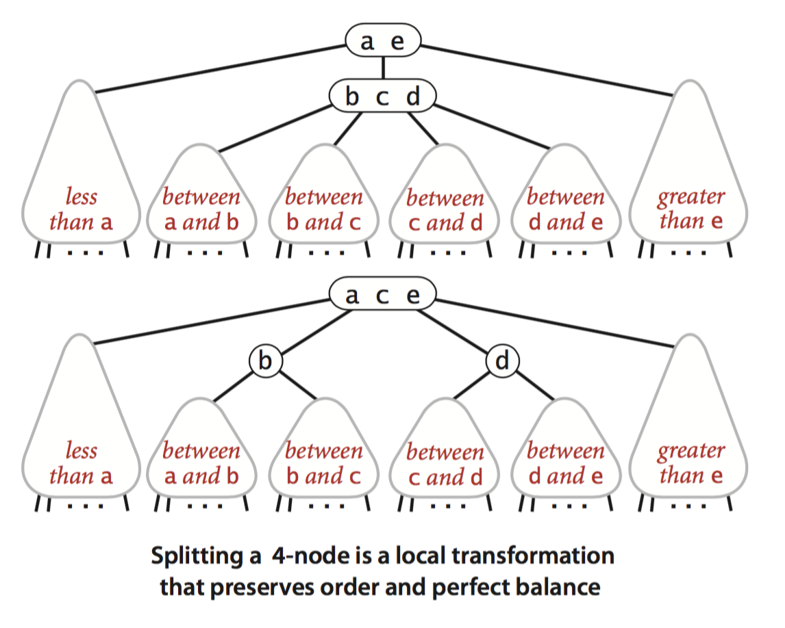
Local transformations in a 2-3 tree
Splitting a 4-node is a local transformation: constant number of operations.

Slide 70
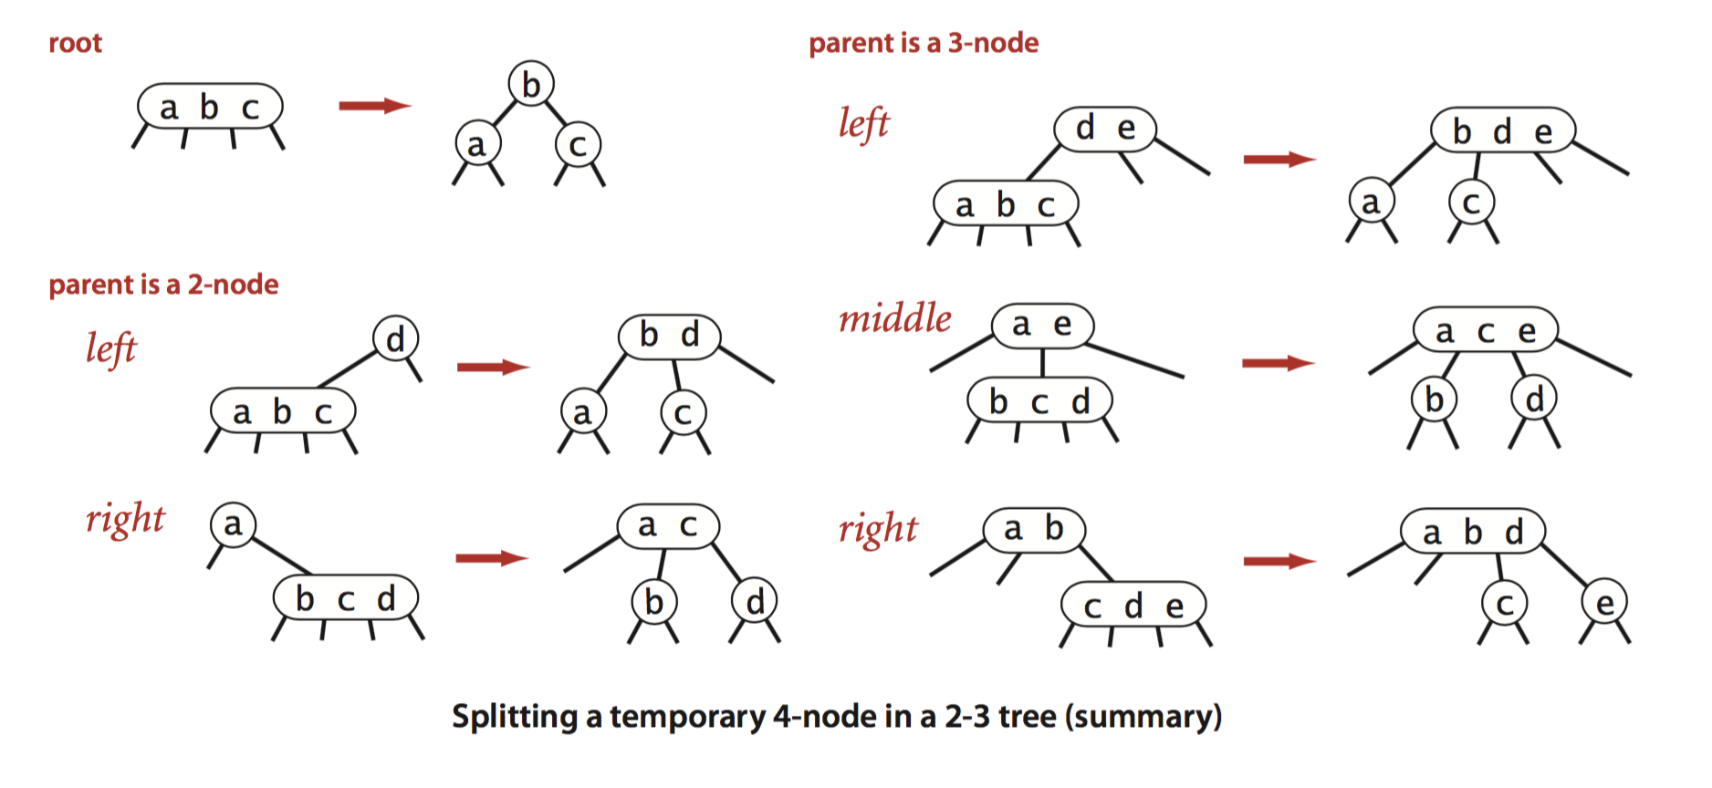
Global properties in a 2-3 tree
Invariants. Maintains symmetric order and perfect balance.
Pf. Each transformation maintains symmetric order and perfect balance.
Notes:
only operation that creates a new node is inserting the first key and splitting the root

Slide 71
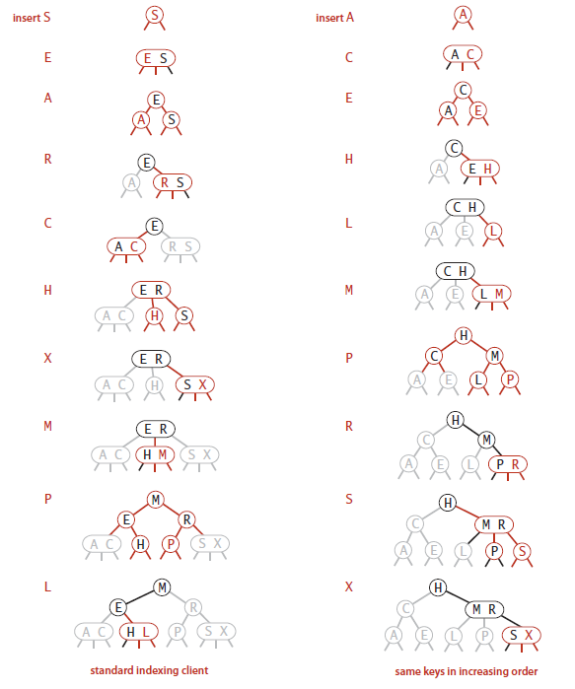

Slide 72

2-3 tree: performance
Perfect balance. Every path from root to null link has same length.
Tree height.
Worst case:
Best case:

Slide 73
2-3 tree: performance
Perfect balance. Every path from root to null link has same length.
Tree height.
Worst case: lg N. [all 2-nodes]
Best case: log3 N ≈ .631 lg N. [all 3-nodes]
Between 12 and 20 for a million nodes.
Between 18 and 30 for a billion nodes.
Bottom line. Guaranteed logarithmic performance for search and insert.

Slide 74
ST implementations: summary
implementation | guarantee |  |  | average case
 | search | insert | delete | search hit | insert | delete
sequential search (unordered list) | N | N | N | ½ N | N | ½ N
binary search (ordered array) | lg N | N | N | lg N | ½ N | ½ N
BST | N | N | N | 1.39 lg N | 1.39 lg N | √ N
2-3 tree | c lg N | c lg N | c lg N | c lg N | c lg N | c lg N
constant c depend upon implementation
Notes:
Ok, but I haven't shown you any code!

Slide 75
2-3 tree: implementation?
Direct implementation is complicated, because:
Maintaining multiple node types is cumbersome.
Need multiple compares to move down tree.
Need to move back up the tree to split 4-nodes.
Large number of cases for splitting.
Bottom line. Could do it, but there's a better way.
fantasy code
public void put(Key key, Value val)
{
Node x = root;
while (x.getTheCorrectChild(key) != null)
{
x = x.getTheCorrectChildKey();
if (x.is4Node()) x.split();
}
if (x.is2Node()) x.make3Node(key, val);
else if (x.is3Node()) x.make4Node(key, val);
}
“ Beautiful algorithms are not always the most useful. ”
— Donald Knuth
Notes:
search is also more complicated
[wayne s14] Knuth quote hidden behind fantasy code

Slide 76
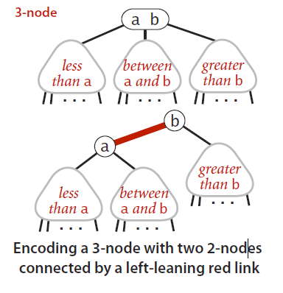
2-3 tree: implementation?- RED-BLACK Trees
RED BLACK TREEs
Definition: red-black BSTs have red and black links and satisfying the following three restrictions:
■ Red links lean left.
■ No node has two red links connected to it.
■ The tree has perfect black balance : every path from the root to a null link has the same number of black links.
Notes:
search is also more complicated
[wayne s14] Knuth quote hidden behind fantasy code

Slide 77
3.3 Balanced Search Trees
2-3 search trees
B-trees
http://algs4.cs.princeton.edu

Slide 78

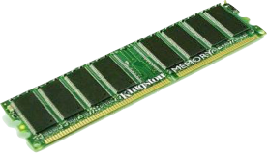
File system model
Page. Contiguous block of data (e.g., a file or 4,096-byte chunk).
Probe. First access to a page (e.g., from disk to memory).
Property. Time required for a probe is much larger than time to access data within a page.
Cost model. Number of probes.
Goal. Access data using minimum number of probes.
slow
fast
Notes:
Typically a page size is about 4096 bytes (on a 32-bit system) or 8192 bytes (on a 64-bit system) so about 1024 pointers fit in memory

Slide 79
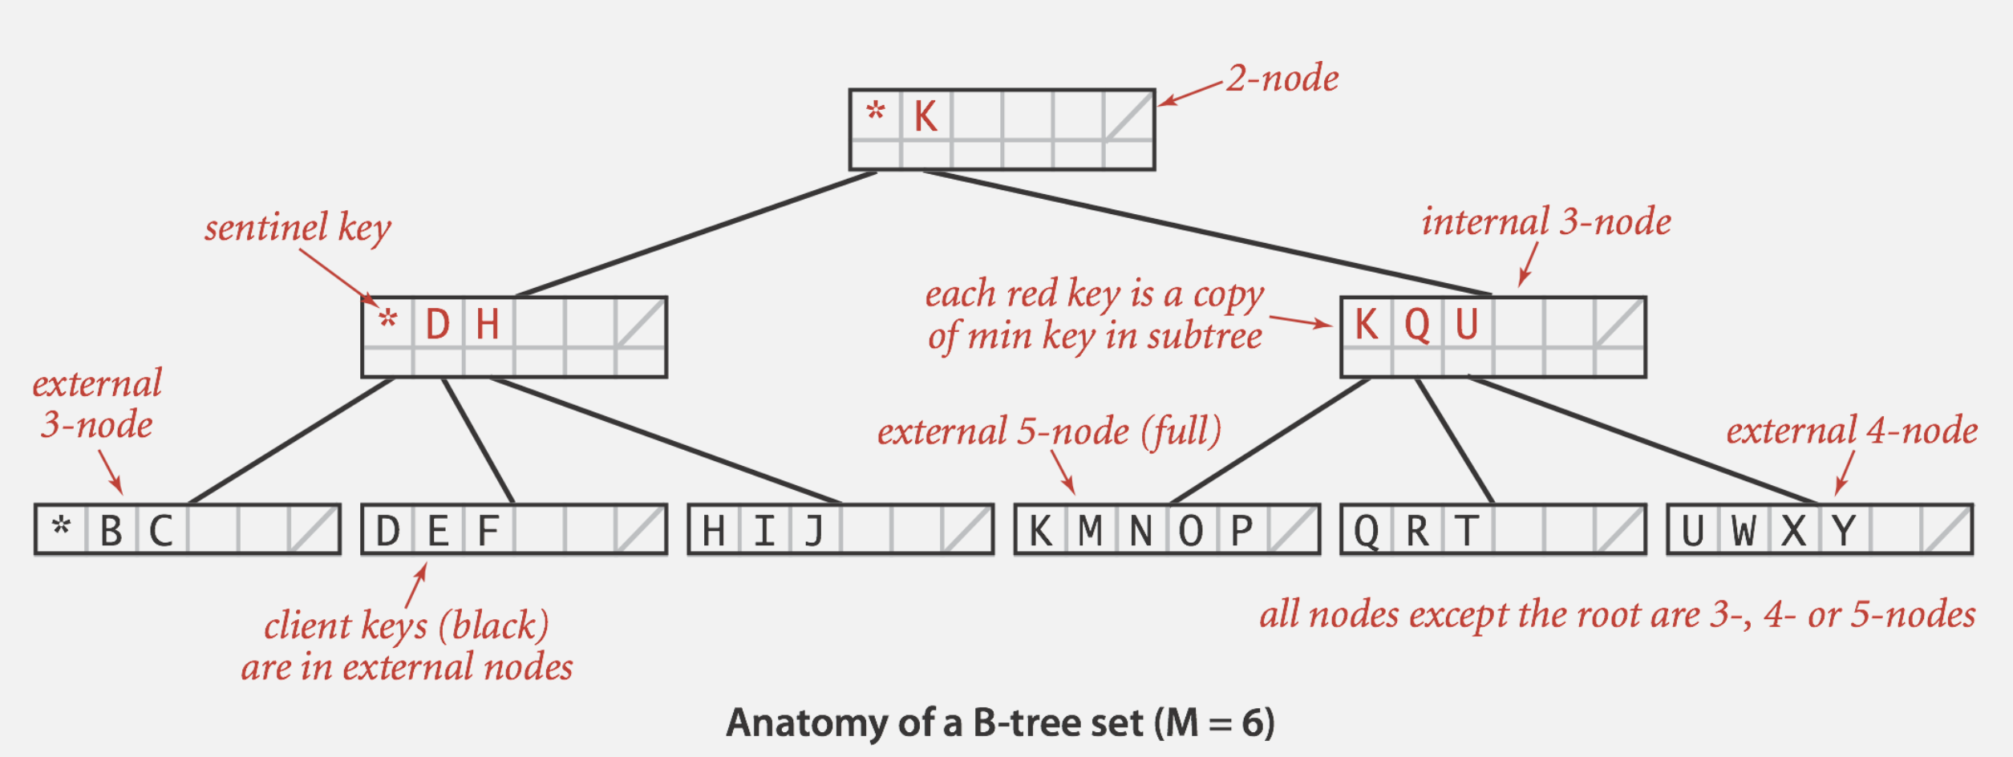
B-trees (Bayer-McCreight, 1972)
B-tree. Generalize 2-3 trees by allowing up to M − 1 key-link pairs per node.
At least 2 key-link pairs at root.
At least M / 2 key-link pairs in other nodes.
External nodes contain client keys.
Internal nodes contain copies of keys to guide search.
choose M as large as possible so that M links fit in a page, e.g., M = 1024
Notes:
multiway balanced search tree
like a 2-3 tree but we allow way more keys in each node
we don't want nodes to get too empty, so we require that each node other than the root be at least half full
typically this is set up so that all of the data is in the external nodes (with no links)
5-node at the bottom is full (though it has room for one more temporary key)
red keys in internal nodes are copies of the keys in the leaves - this just makes the implementations a bit easier

Slide 80
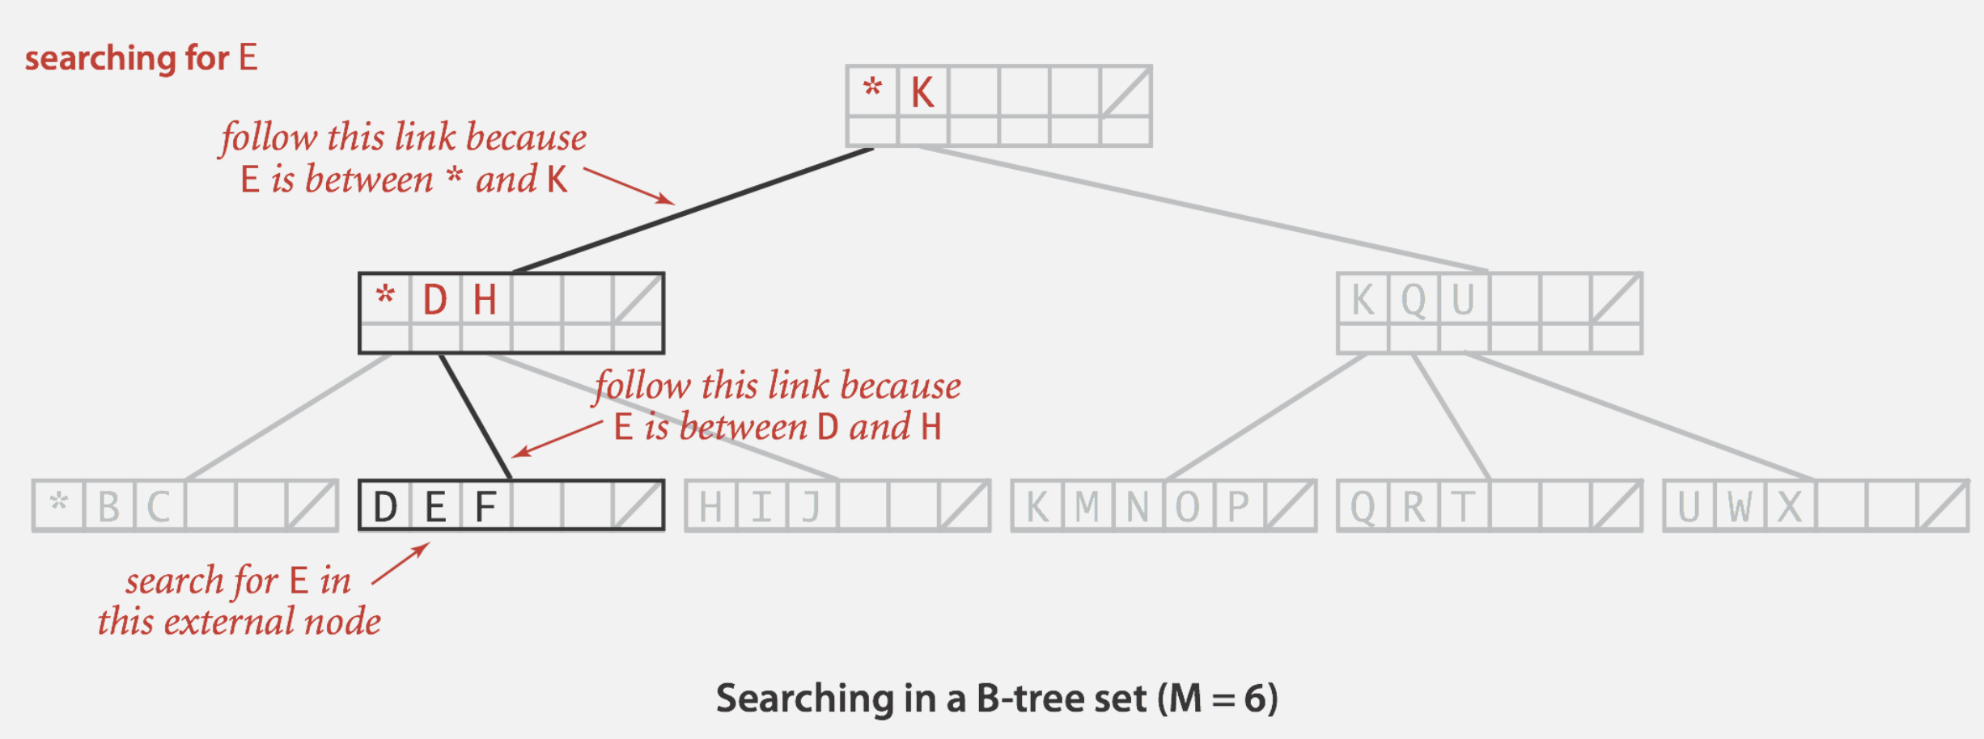
Searching in a B-tree
Start at root.
Find interval for search key and take corresponding link.
Search terminates in external node.
Notes:
search is a natural generalization of search in a 2-3 tree
Red-black abstraction still works, but might use binary search instead of instead of internal links.

Slide 81
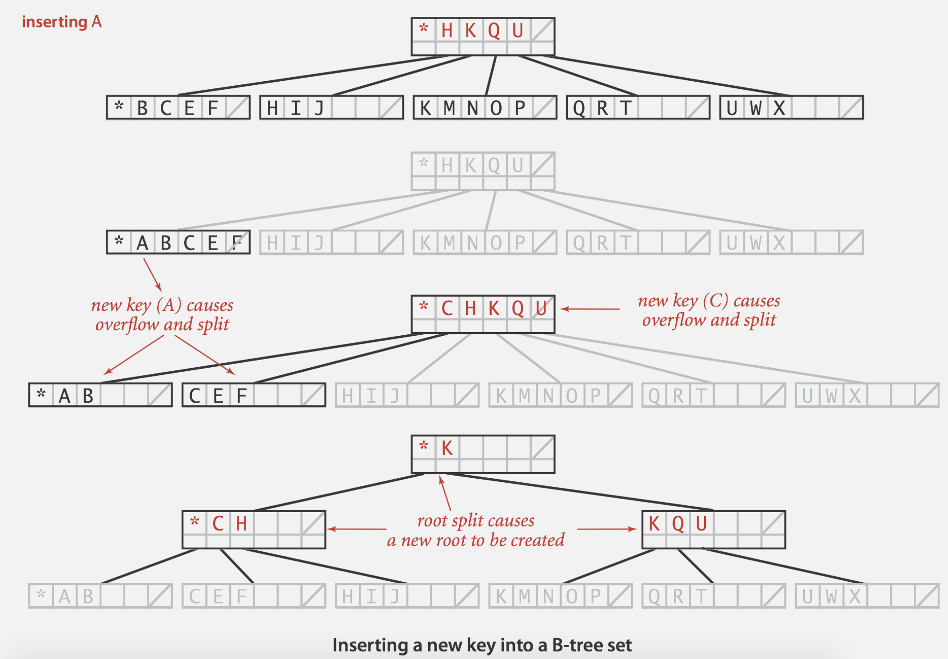
Insertion in a B-tree
Search for new key. Insert at bottom.
Split nodes with M key-link pairs on the way up the tree.
Notes:
adding A to the leftmost leaf node makes it overfull so we break it up into two nodes, moving copy of middle key to parent
in this case, the parent becomes full, so we need to split that one too

Slide 82
Balance in B-tree
Proposition. A search or an insertion in a B-tree of order M with N keys requires between log M−1 N and log M/2 N probes.
Pf. All internal nodes (besides root) have between M / 2 and M − 1 links.
In practice. Number of probes is at most 4.
Optimization. Always keep root page in memory.
M = 1024; N = 62 billion
log M/2 N ≤ 4

Slide 83
Balanced trees in the wild
B-tree variants. B+ tree, B*tree, B# tree, …
B-trees (and variants) are widely used for file systems and databases.
Windows: NTFS.
Mac: HFS, HFS+.
Linux: ReiserFS, XFS, Ext3FS, JFS.
Databases: ORACLE, DB2, INGRES, SQL, PostgreSQL.
Notes:
B+ internal nodes can hold more branches since they don't store data
HFS = hierarchical file system
HPFS = high performance file system
JFS journaling: "This kind of buffer is commonly used in file systems — the disk cache — and databases to increase overall performance. The problem appears if there is a system crash, before the buffers have been written to disk, that would cause the system to behave in an inconsistent way after system reboot." databases and filesystems need to recover. journaling enables this

